Slide 1
Software process models
Classical software development lifecycle model
Prototyping model
V model
SDLC
Incremental model

Slide 2
Classical software development lifecycle model

Slide 3
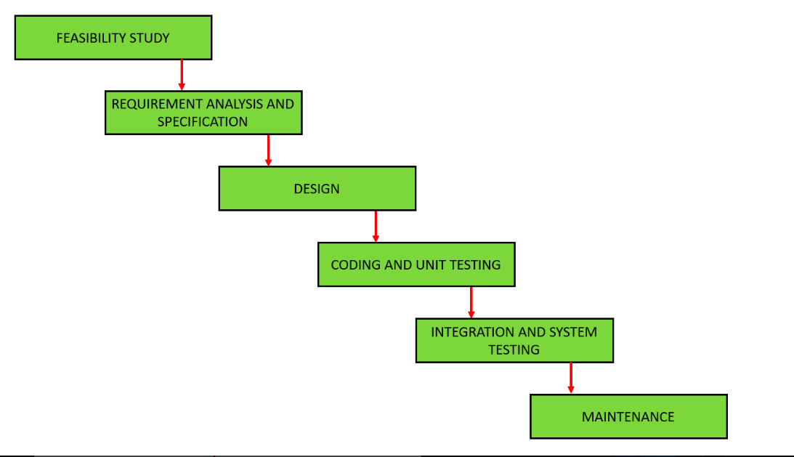

Slide 4
Classical waterfall model is the basic software development life cycle model
It is very simple but idealistic
one phase can be started after completion of the previous phase
phases do not over lap with each other.

Slide 5
Feasibility Study:
financially and technically feasible to develop the software
understanding the problem and then determine the various possible strategies to solve the problem.
The best solution is chosen
Requirements analysis and specification
understand the exact requirements of the customer and document them properly
This phase consists of two different activities.
1st activity : Requirement gathering and analysis
requirements regarding the software are gathered from the customer and then the gathered requirements are analyzed
remove incompleteness

Slide 6
2nd activity :Requirement specification:
analyzed requirements are documented in a software requirement specification (SRS) document
SRS document serves as a contract
Design :
transform the requirements specified in the SRS document into a structure
Coding and Unit testing:
translated source code using any suitable programming language.
check whether each module is working properly or not.
Integration and System testing:
Integration of various modules is carried out incrementally over a number of steps
previously planned modules are added to the partially integrated system
resultant system is tested.

Slide 7
the full working system is obtained and system testing is carried out on this.
System testing consists three different kinds of testing activities
Alpha testing:
system testing performed by the development team.
Beta testing
performed by a friendly set of customers
Acceptance testing
customer performed the acceptance testing

Slide 8
Advantages of Classical Waterfall Model
This model is very simple and is easy to understand.
Phases in this model are processed one at a time.
Each stage in the model is clearly defined.
This model has very clear and well undestood milestones.
Process, actions and results are very well documented.
Reinforces good habits: define-before- design, design-before-code.
This model works well for smaller projects and projects where requirements are well understood

Slide 9
Drawbacks of Classical Waterfall Model
No feedback path
Difficult to accommodate change requests
No overlapping of phases

Slide 10
Prototyping model
Prototyping model is appropriate when
Customers have general objectives of software but do not have detailed requirements for functions & features.
Developers are not sure about efficiency of an algorithm & technical feasibilities.
It serves as a mechanism for identifying software requirements. Prototype can be serve as “the first system . Both stakeholders and software engineers like prototyping model
Users get feel for the actual system
Developers get to build something immediately

Slide 11
Need:
1. Customer defines a set of general objectives for software but is not able to identify detailed input, processing, or output requirements
2. The developer may be unsure of
a) Efficiency of an algorithm,
b) Adaptability of an operating system
c) Form that human/machine interaction should take.

Slide 12
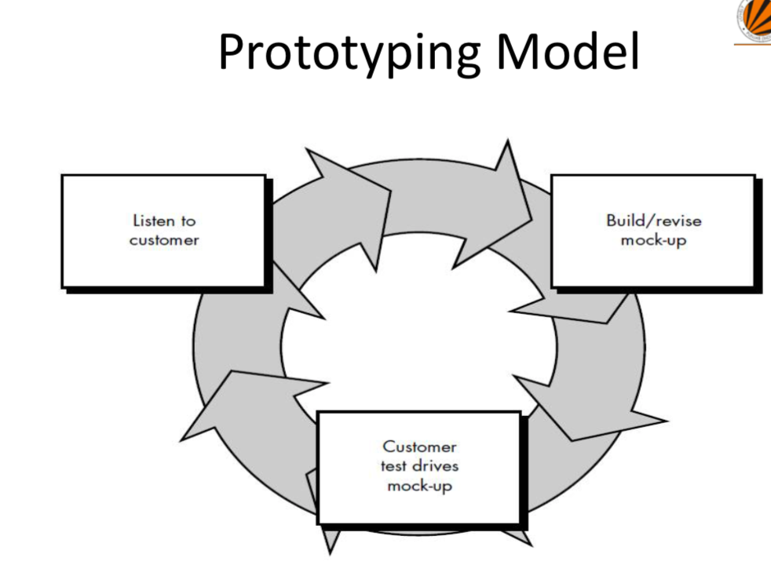

Slide 13
It works as follow
Communicate with stockholders & define objective of Software
Identify requirements & design quick plan
Model a quick design (focuses on visible part of software)
Construct Prototype & deploy
Stakeholders evaluate this prototype and provides feedback
Iteration occurs and prototype is tuned based on feedback
Problem Areas
Customer demand that “a few fixes” be applied to make the prototype a working product, due to that software quality suffers as a result
Developer often makes implementation in order to get a prototype working quickly; without considering other factors in mind like OS, Programming language, etc.

Slide 14
Advantages
Users are actively involved in the development
Since in this methodology a working model of the system is provided, the users get a better understanding of the system being developed
Errors can be detected much earlier

Slide 15
V MODEL
the V-model is an extension of the waterfall model.
V-model carries out its execution in a sequential manner.
termed as a Verification and Validation model.
each phase has to be finished before beginning the next phase

Slide 16
